Slide 1
An Energy Efficient, Real Time Task Scheduling and Resource Allocation Paradigm for Virtualized Cloud Environment
A Virtualization Project by Faraz Ahmad

Slide 2
Abstract
The success of virtualization and cloud computing makes an increasing number of real-time applications such as signal processing and weather forecasting run in the cloud. With the increasing popularity of virtualization, the number of tasks occurring in the virtualized environments have increased at an enormous amount. The proposed work surveys a series of currently existing task scheduling and resource allocation algorithms with respect to their characteristics and performance in order to establish a paradigm for efficient task management in a virtual cluster environment. The proposed work includes analysis and survey of various currently existing task scheduling algorithms. The various algorithms will be analyzed for scheduling criteria which are later used to find out the most efficient algorithm. The aim is to successfully implement the task scheduling algorithms and come up with a new improvements algorithm.

Slide 3
Methods
The algorithms to be analyzed include First Come First Serve, Shortest Job First and Max Min Scheduling, Energy aware scheduling, bidirectional bidding mechanisms etc. The simulation of virtual machines will take place on cloudsim integrated by eclipse, a java based integrated development environment. The concept of space and time shared virtual machines will also be explored. Keywords: Virtualization, Virtualized Cloud, Task Scheduling, Resource Allocation.

Slide 4
Problem Statement
There is a paradigm shift by using technology as a utility by end users. Cloud computing paradigm is following the characteristics of utility based computing. Under the category of distributed computing, utility computing includes grid and cloud computing. This research work highlights the efficient task scheduling at the virtual machine level. When tasks are scheduled over the virtual machine users need to allocate the tasks to the respective virtual machines.

Slide 5
Metrics for Designing a Good Task Scheduling Algorithm
Increased Efficiency
Reduced Throughput
Performance of individual machines in Virtual Clusters
Increased Fault Tolerance
Scalable through use architectural and deployment paradigms.
Less Power Consumption

Slide 6
What the proposed work aims to achieve
01
Perform a research study on the various task scheduling algorithms used for scheduling virtual machines in a virtual cloud environment.
02
Explore the importance of time and space shared virtual machines
03
Implement the various task scheduling algorithms in the cloudsim toolkit, a java framework for simulating virtualized environments.

Slide 7
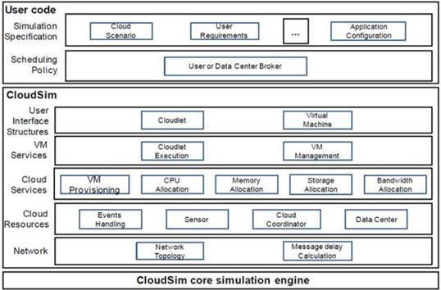
Tools Used
Java
Cloud SimToolKit
Eclipse IDE

Slide 8
How it works
04
Cloud Information Service
Simulate
After all the details are established, cloudlets( tasks) are assigned to the data centers.
Registry which contains the resources on the cloud like the data centre and hosts or virtual machines
01
03
Host Virtualisation
Creating a data centre
The host is virtualized into a number of virtual machines and host can have a number of virtual machines. A broker is created which takes tasks from the CIS and submits it to the data centre
Each data centre has a host and every host has a hardware configuration like number of processing elements, RAM
02

Slide 9
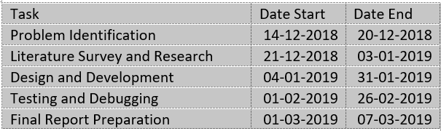
Gantt Chart

Slide 10
Conclusion
The proper analysis of task scheduling algorithms will result in designing proper, efficient and scalable infrastructures for handling tasks in a virtual cloud network.

Slide 11
Thank you!

